Slide 1

BACHELORS AND MASTER THESIS

Slide 2
Introduction What is a bachelor’s and master’s Thesis all about?
The ability of a student to independently conduct and report on scientific research, ensuring their scientific knowledge increases post thesis completion. The student is the primary contributor, with global supervision and guidance from a supervisor.

Slide 3
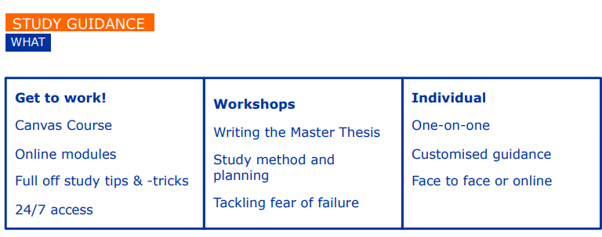
Need help?
Study guidance
Your supervisor

Slide 4
EXPLORE MORE
Thesis seminars
Thesis market

Slide 5
Start with making a good plan. Tools to use for making your plan : Sharepoint,excell Tips and tricks: Remember to include smart goals and deadlines in your planning

Slide 6
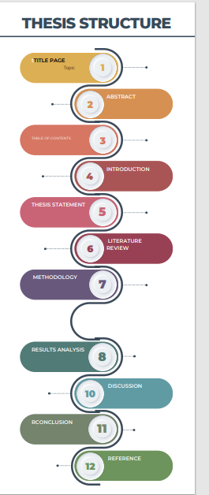

Slide 7
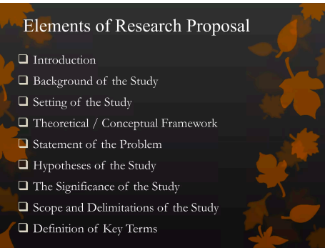
Research Proposal

Slide 8
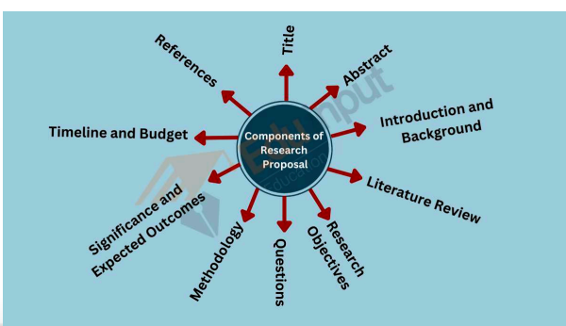

Slide 9
How to select a research topic
1)What projects are staff working on,do they interest you?
2)Has a professor mentioned a research study that you found interesting?
3)Look in Professional journals to see current issues and concerns and if they have a research possibility
Considering the courses you followed which area were you most interested in?
Your motivation and interests
are key éléments to consider when choosing the topic.
Tips and tricks

Slide 10
Identify an area of intrest
Talk to your tutors about your ideas
Reflect and explore possibilities:-departmental research projects,current professional issues
Identify sources of information:
Do a reconnaissance of available literature using search engines like-web of science,google scholar etc
Collect anything that looks intresting and useful
Key concepts
What research has been done on the topic?
What research questions have been asked?
What methods have been used?
Suggest possible research questions for your research
Consider if their is sufficient data available
Talk to your promoter about your topic analysis

Slide 11
Did you know that!
No matter the number of studies on a topic, no topic is ever closed –all have more possibilities for research

Slide 12
Features of a good topic
What to avoid when choosing a topic:
Choosing a topic in a hurry
Selecting the method before the topic
Not involving your promoter
Data availability
Time availability
Capabilities and skills
Symmetry of potential outcome

Slide 13
Methodology
Consider methodological approaches like qualitative or quantitative that you could like to use
TIPS
Check if other researchers have done research on the topic
Find out what research questions did they ask
What methodology and data collection tools did they use
Did they use a hypothesis
What were there findings
You can deconstruct an existing research and develop it in a different way from the original one

Slide 14
What is literature
It is made up of various published and non published items

